Slide 1
Questions
If you have questions about any part of NCAP, we ask you use the chat function to pose it.
We will monitor the chat function and ensure we answer all the questions.
If you get a reply “answered during presentation”, it will be covered in our presentation.
If not, we will bring the.
question up for an answer.
Notes:
Jeff;
We are going to use the Chat function a lot today. First, at anytime you may pose a question to us. ! will monitor the chat function to ensure all questions get answered. The answer could come in our presentation today. If so, you will see the rely “answered in presentation”. If it is not answered in the presentation, we will discuss the answer. Periodically, the presenter will request if there are questions needing answers, The person monitoring will pose the question to the presenter for an answer,
Please do not ask questions using audio function. With this many people in attendance, there is no good way to sort out who asks first or having people talking over one other.

Slide 2
Study Groups
We will Break up into Study groups.
Study groups will look at a standard and/or a situation and draw conclusions.
Study groups will report back.
Presenter will provide “Best Practice” answers.
Notes:
Jeff;
At any time, you can pose questions to us and we will hopefully be able to answer it. If not, we will find the answer and get back to everyone.
We are going to use Study Groups a lot today. Each table is a study group. At certain points during the presentation, we will pose a question, assessment situation or NCAP Standard that each study group will look at. We will give the groups 10 minutes to discuss an arrive at a group answer. We will report back and then look at answers we arrived at. Many of the assessment scenarios are ones that happened during an assessment.
Bob will perform breaking the class up.

Slide 3
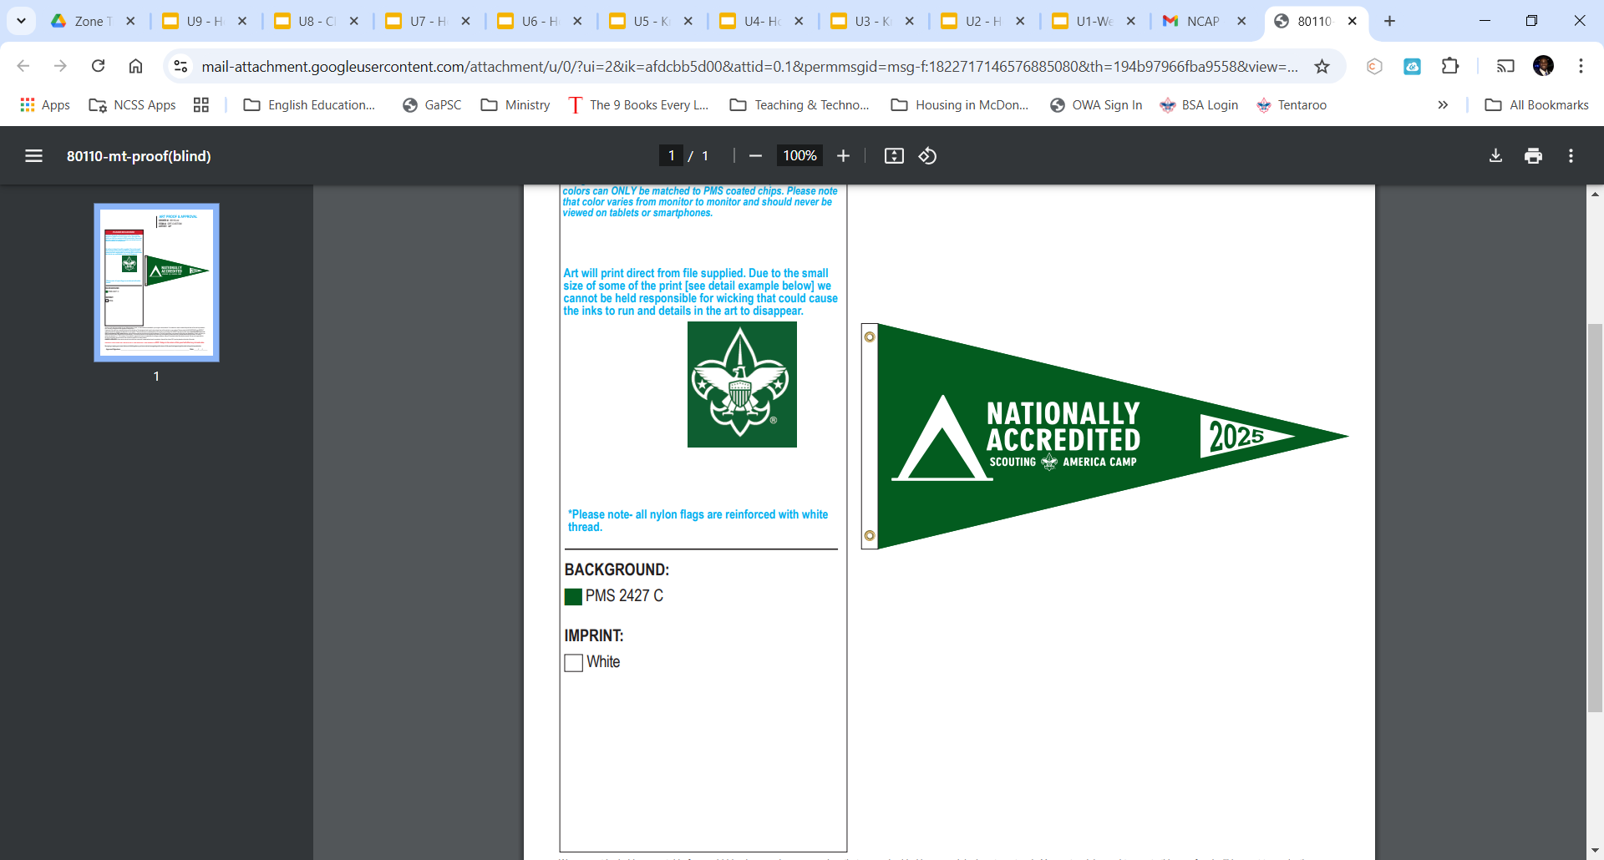
Zone 15 Camp Assessment Seminar - 2025
National Camp Accreditation Program
Boy Scouts of America
HTTP://ncapzone15.org
Notes:
Note to Lead Instructor for this course. Have each presenter hand in a list of forms he wants transmitted to each attendee and have them stored on our web site. .This transmission will be electronic at the start of the training session, i.e., send participants link to download forms.
You should have received a set of 2025 NCAP standards when you registered. Did anyone not get one today. (Someone from team should go out and get standards for all who did not pick one up earlier).
Jeff: Good Morning, Let me introduce the leadership team for Zone 15.
Introduce the team.
Tim Harper (ONS). Ass’t. Zone Coordinator.
Bob Ormseth (Palmetto), Ass’t. Zone Coordinator
Paul Corcoran (Old Hickory) Ass’t. Zone Coordinator
Bill Spence: (CVC) COPE/Climbing Coordinator, former COPE/Climbing advocate for SR7,
Alexander Timcovich: (Mecklinburg) COPE/Climbing Coordinator, Former COPE/Climbing advocate for SR5.
Jim Sheckels (OCC) : Computer setter upper.
Jim Miles: (Mechlinburg) Assessment Coordinator
And I am, Jeffrey Irving (Tidewater) , NCAP Zone 15 Lead Assessment Coordinator
Jim Sheckels set up our web site. The Link to it is in the lower left hand corner of thr screen. From time to time , we will post information on the web site so you can acquire them.

Slide 4
Welcome Seminar Agenda
Q & A on online training.
Overview Zone 15 Set-up.
Zone 15 Best Practices.
Working With CCIPs.
Standard Changes 2025.
Range and Target Activities.
Assessment Study Scenarios.
Questions & Answers.
Notes:
Jeff
Go over the agenda
This seminar contains very little that deals with the NCAP subjects in the online training. However, let’s take a few minutes and answer any questions you might have about the online modules. Today’s seminar compliments the online training and outlines the direction Zone 15 takes in performing assessments.
At times, we highlight one of the areas in camp. In future presentations, we want to highlight other program areas and their related standards. When you receive today’s evaluation form, you will be asked what other program areas would you like to see highlighted. Our goal is to provide training modules that will allow you to be a well informed and trained assessors in all program areas of camp. Today, we will visit the Range and Target Activities Area (Shooting Sports)

Slide 5
The purpose of the Boy Scouts of America’s National Camp Accreditation Program (NCAP) is to help councils elevate camps to new levels of excellence in delivering Scouting’s promise to youth.
NCAP uses an interwoven process of application, analysis, authorization, continuous camp improvement, assessment, and accreditation to achieve this purpose.
Notes:
Jeff:
This is the opening statement in the Area Implementation Guide. The Guide is still valid for Council Service Territories and Zones. It is listed as a resource on the NCAP website.
Instructor to read the Statement. Would anyone want to venture a guess what the second paragraph says?
To me, this affirms that we are assessors, not inspectors. We are told to interact with our councils. We are in the business of keeping our camps safe and a fun place for youth. We are in the business of working along with our camps to keep them open while still ensuring the standards of BSA are met. To the best of our ability, we are duty bound to help them.
Hopefully, we can help clear the obstacles they are facing, and we can accredit their camp. Occasionally, a non-compliant occurs so close to the assessment day that during the camp assessment we cannot help clear it.

Slide 6
NCAP Resources
www.scouting.org/NCAP
Primary resources are:
Council Implementation Guide
Area Implementation Guide
Notes:
Jeff:
This is the latest NCAP Implementation Guide. National has published a new Council Implementation Guide and they working on revising the Area Guide to fit a Zone.
It is the primary source of information on implementing the NCAP program throughout Zone 15. If you have not, you should become familiar with its contents. You should perform assessments which mirror these documents.
Please familiarize yourself with updated Council Implementation Guide.
Both Documents are posted on the NCAP web site.

Slide 7
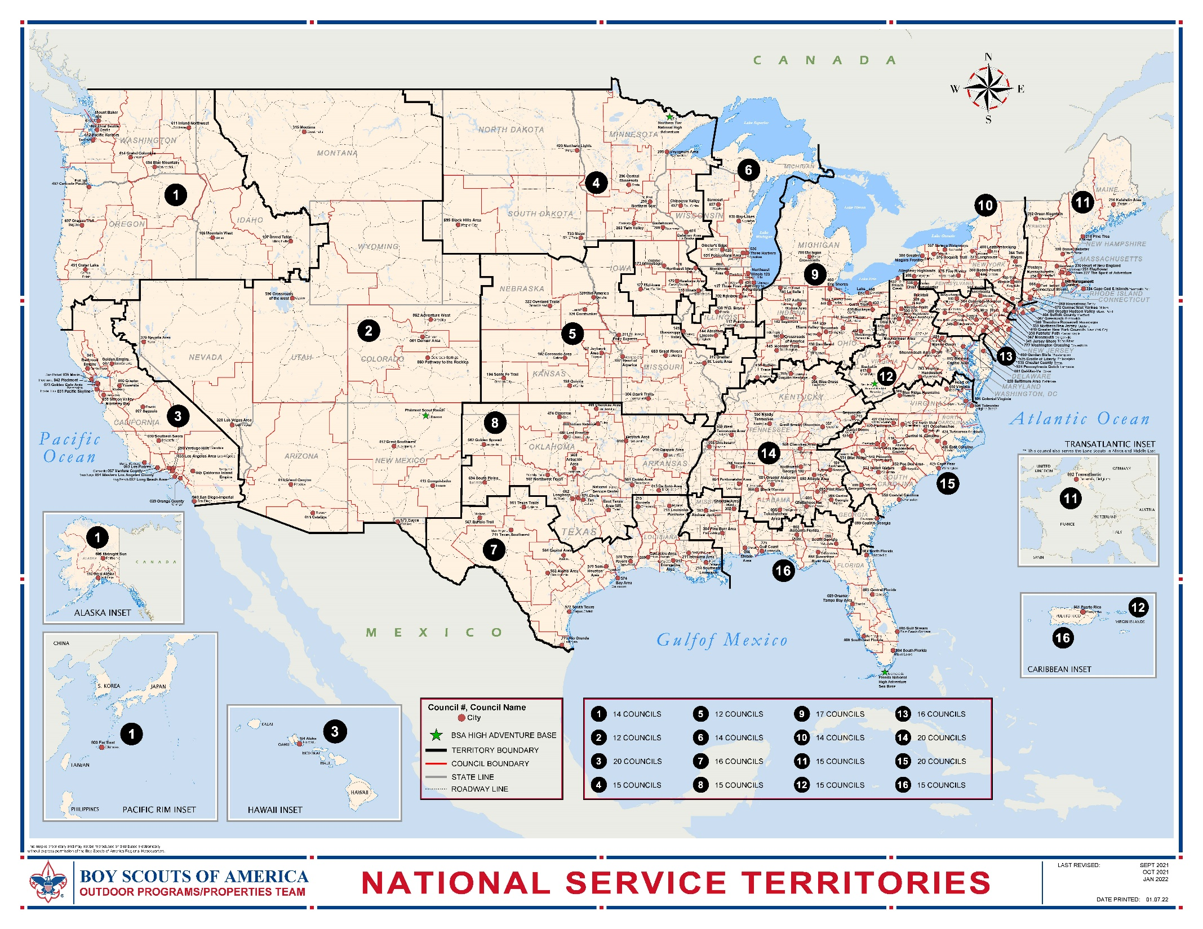
Territories
Show Territory US map
Notes:
Jeff:
By now, all of us should be familiar with the new National structure of scouting As a result of the declaration of bankruptcy, the BSA is required to determine a smaller, more financially sustainable management structure. The BSA removed one level of management doing away with the old region/area structure. They chose to become 16 Territories with smaller volunteer/professional staffs. The territory staffs work directly in support of our local councils. The territories were known as Nation Service Territories, or NST. This has been changed to Council Service Territories, or CST. The number of Territories has change to 14. Zone 3 was eliminated and split between other territories. Zone 11 to the adjoining Territory.
NCAP is made up of 14 Zones that mirrors each territory and administers the NCAP requirements in that Territory. Look at CST 2. How would you go about adminstering that CST, or Zone 2. We perform all long-term camp assessments in the Territory. We will convey to you in this seminar how Zone 15 will perform the required LT camp assessments. Look at Territory 11.
NCAP is not included in the territory structure. NCAP is a separate and distinct organization. At the top, you see we are under the National NCAP Committee. We are NCAP Zone 15 and provide service to CST 15. There are 14 Lead Zone Coordinators in BSA. We are in the infancy of this new national structure and I am sure there will be more changes.
As you are probably aware, there are Short Term Camp Administrators (STCA who do council self assessments on any camp under three nights long. National keeps saying there will be a review of the council's self assessments and hint we maybe involved, but no decision on that as of today.

Slide 8
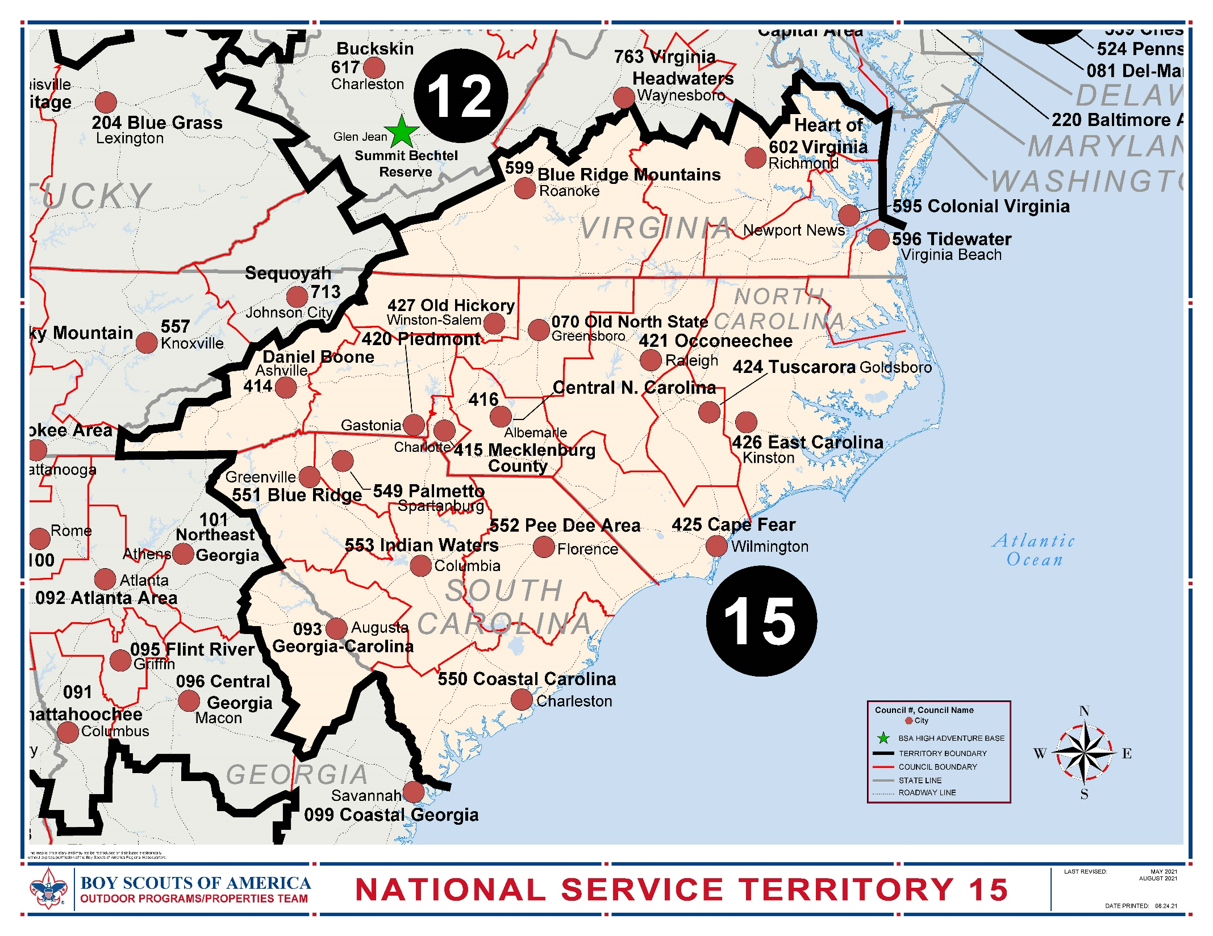
Zones
Show Territory 15 map
Notes:
Jeff:
Here is the Territory 15 map. It is made up of 18 local councils stretching for Virginia to Georgia. Just recently, Indian Waters and Pee Dee councils merged. These 18 councils have 17 camp properties used for Cub Scouts. Scouts BSA and Venturing Scouts long term camping. Colonial Virginia Council and Palmetto Council do not have a camp property. Mecklenburg County Council has two camp Properties used for Long Term Camps. We perform approx. 25 LT camp assessments each year.

Slide 9
Notes:
Jeff:
NCAP is not included in the territory structure. NCAP is a separate and distinct organization. At the top, you see we are under the National NCAP Committee. We are NCAP Zone 15 and provide service to CST 15. There are 14 Lead Zone Coordinators in BSA. We are in the infancy of this new national structure, and I am sure there will be more changes.
As you can see, there are three parts to the NCAP process. The Council is shown on the middle line. On the left is NCAP Assessment process. On the right is the NCAP authorization process.
Note To Presenter: Read down each line and say a word or two.
Who is the key person in this diagram? Can anyone tell me? Council NCAP Chair. And the important person in the assessment process is the Team Lead.
The important person in the authorization process is the Authorization Reviewer. Many times, the Councils choose another person to head up their requirement to obtain authorization to conduct a camping program under the auspices of Scouting America.
The Authorization Process occurs every 5 years for a council. It requires the council to assembly for the last 5 years information on their finance, profitability, attendance, improvement in their camp facilities, etc.
Are we involved in the authorization process. Yes. Under Standard AO-810 we are required to keep the authorizes informed about the conditions of each camp, normally captured in the council’s camp improvement plans. The authorizers can inset specific requirement the councils must perform during the authorization period. These specific requirements are graded as an NCAP Standard.
More about this later today.

Slide 10
The State of Camping In BSA
Attendance – Down significantly
Cost - Up Sharply
Profitability – in question
Can We Help?
Notes:
Jeff:
Let’s talk about the state of camping in Scouting America. I am going to speak frankly, and these are my thought., not Nationals nor anyone else.
For many reasons, primarily because of court cases and declaring bankruptcy, the number of scouts is significantly down. In 2020, the year of COVID, almost every camp in Scouting America was closed. When they opened in 2021, attendance figures showed a large downturn in attendance. Many councils are struggling to regain attendance. Not enough Scouts to go around.
It is obvious to anyone that cost have risen and aren’t show any signs of slowing down. We all feel the burden of rising cost everyday.
Councils are having to cut back on the number of weeks they conduct long term camping. This affects their ability to attract staff members.
The big question for us –How can we help? Let me hear your thoughts.

Slide 11
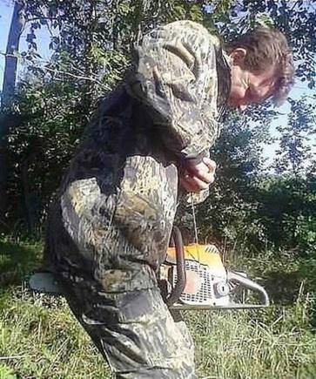
Safety First
Notes:
Jeff (Last Slide):
Let’s have a safety moment. Part of our job is to ensure all power tools are being handled safely.
Do you see anything wrong with this photo?
He does not have sound protection on.

Slide 12
Conducting LT Camp Assessments
Notes:
Tim:
Let’s talk about how we as assessors will conduct ourselves in Territory 15. The leadership team has done a lot of thinking and talking about becoming one Zone. We keep working on melding the way we did assessments into one way. After you see what is prepared for today, we would love to hear your thoughts on becoming one Zone. Please write them on your evaluation sheet.

Slide 13
Zone 15 Best Practices
In general:
Wear a “Class A” uniform.
Carry your physical (Part A and B), carry your YPT and NCAP training certificate with you.
Be friendly. Praise camp staff if you see outstanding performance
Solicit thoughts from campers by asking open ended questions, “How is your stay at camp turning out for you?”
Notes:
Tim:
There can be times it is too hot to wear a full field uniform. The TL will determine that and inform everyone to take off their uniform shirt and revert to the activity uniform (commonly known as “Class B”)

Slide 14
Zone 15 Best Practices
We are assessors, Not inspectors. We are in the business of assuring BSA camps comply with NCAP Standards and conduct fun filled and safe camps.
We assist our camps in correcting non-compliant conditions and meeting standards. Hopefully, well before the day of assessment so we can accredit the camp.
Notes:
Tim:
An inspector deals in yes or no answers in performing the inspection. An assessor assists the camp staff early-on so the standard can be compliant before the assessment takes place. We do not bend or break rules of the standards. We develop relationships with Camp personnel, so they understand we are on their side. Well before Assessment day, TL work with their assigned council to assist them in obtaining solutions to problematic situations and obtaining variances, waivers, or equivalency determinations.
There are times that assessors who work in certain aspects of our standards, (for example Safety Inspector, Fire Inspector, even those who understand food service regulations) will see things that other do not and their rule governing the situation is not part of the Verification of a standard. If the situation is not covered by the Verification, we cannot use it during the grading of the standard. However, we should recommend to the camp staff they study the effect of the situation and take appropriate action. If it is a Safety issue, we are duty bound to bring it to the camps attention and ensure it is resolved. In this case, bring the situation back to your TL for resolution. Do not discuss with the camp staff, The person to do this is the Team Leader.
We Help the camp staff to learn and use best practices.

Slide 15
Zone 15 Best Practices
Team leads work year-round with a council for 3 years and is responsible for all LT assessments.
Page 16, Area Implementation Guide
“Develop a rotation schedule, so that Team Leader..
SE’s request we do this.
It helps build relationships with council volunteers and staff
2nd & 3rd year assessments are easier to perform.
Outgoing TL pass info to
incoming TL.
Notes:
Tim:
Read through Slide.
Second bullet Develop a rotation schedule, so that Team Leaders establish some continuity in working with a Council but shift Council assignments every three years to provide fresh perspectives.
The SE’s and staff were having trouble understanding and communicating with assessors when they changed every year. They wanted some consistency with all their assessments. Assigning the TL for a three-year period helped everyone build a closer relationship in performing assessments. Councils knew there was a person they could talk to about the standards and applying them.
Performing a council’s assessments for 3 years makes it easier to perform the assessments. Some paperwork does not change significantly from year to year and can be reviewed more easily. TLs can see the progress camps are making toward the CCIPs.
Outgoing TL must pass their notes to the incoming TL, helping the continuity

Slide 16
Zone 15 Best Practices
Become fluent in knowing and understanding the standards.
Study the camp’s leader’s guide, camp maps, parent information and other information posted to their web-site or disseminated to the parents and participants.
Assess various camps throughout Zone 15 and assess different areas in camp.
Notes:
Tim:
If you are having difficulty understanding a standard, speak-up and get clarification. You can talk to your team leader, Jose and/or myself or other people who are knowledgeable. If we do not have the answer, we will get you one from National. It is helpful to have the standards with you during the assessment and to refer to it for resolution of questions. If unsure of resolution, “park” it until you confer with team leader and others.
Learn about the council and their camps before you go on an assessment. Read through the leader guide. Look over camp maps. Most of all, see what they are telling parents. Ask yourself are they delivering what they published and distributed to parents, youth, etc.
We need assessors who will go to a variety of camps to understand how they operate under differing conditions. You probably have certain interests that point you to assess certain areas of camp (i.e., you work on a cook crew and understand kitchens). You should become well rounded in all areas of a camp and feel comfortable in assessing any area. It is not possible to form an assessment team so that they have SMEs for every area of camp.

Slide 17
Zone 15 Best Practices
Conduct your assessment considering the Strategic Camp Improvement Plan and Annual Camps Improvement Plan
Ensure your comments on the council’s progress on their plans are included in the comment section of the score sheet.
Notes:
Tim: : AO-810 says in the verification section:
“The camp assessment team should review the Authorization to Operate and any attached camp strategic improvement plan, and comment in
the report on whether steps called for in the camp strategic plan were implemented in a timely manner. However, an explained failure or delay
is not the basis for a noncompliant or deviation finding if the council has made other improvements.
On the annual plan, the camp assessment team should review the Declaration of Readiness to ensure it includes:
the prior year’s goals, metrics, and success criteria, and whether the goals were successfully achieved and, if not, any lessons learned;
the current year’s goals, metrics, and success criteria.
Failure to have prepared and measured goals in the prior year reported in the Declaration of Readiness or failure to have prepared and be measuring goals in the current year by the date of assessment warrants a noncompliant finding. Partial or late compliance should be noted with a deviation.”

Slide 18
Zone 15 Best Practices
Take comprehensive notes. Hopefully, they are framed in a positive light
Assist the team leader in writing the commentary on the score sheet. Give him statements that speak to the principle of a standard.
Notes:
Tim:
One of the most important duties you have during an assessment is taking notes that truly reflect how you are assessing the camp. Say to yourself, “from what I have observed today, this area’s is mediocre.” Your written notes and comments must substantiate how you feel the area is mediocre.
At the wrap-up meeting ,or after the assessment is completed, all assessors turn-in their well written comprehensive notes to the TL. The TL conducts a session with the team members on composing the assessor notes into a meaningful dialog. A dialog that tells the reader how well the camp is delivering the promise of Scouting to the participants. It explains how well the camp is meeting the goals of their CCIP. It verifies the scoring of the standards.
The Zone assessment coordinators and National NCAP Committee will not accept score sheets that have one or two words in the commentary portion.

Slide 19
Zone 15 Best Practices
We are in the business of
keeping
safe and fun filled camps
open.
Notes:
Tim:
This is why we are not inspectors. This is why we are assessors assisting our councils in maintaining high quality safe places scouts can build fond memories. If we preform our job correctly, councils meet all the standards. They improve their facilities and staff.

Slide 20
What NCAP documents are required to perform a LT camp assessment?
Notes:
Tim: Note-This is a study group question. Pose the question and get a report back.
Refer to Slide and NCAP Circular No. 17

Slide 21
Documents Needed
Area (Territory) Implementation Guide
2025 NCAP Standards
Previously approved variances, waivers and/or equivalency determinations
Previous years score sheet
Authorization documents
Notes:
Tim:
Go over slide
Follow on question:
Which of these documents does the TL supply to a team member?
Any that apply to their assigned area of the assessment.
TLs have access to the Authorization documents They will pass on to you any conditions that affect your area of the assessment.
There are various documents that pertain to your area of assessment. Such as, “Range and Target Activities Manual. 2024 addition.”
Team members are responsible to obtain their own set of up-to-date NCAP Standards.

Slide 22
Working with the CCIPs or ACIP CSIP Standard AO-810
Notes:
Paul:
The Continuous Camp Improvement Plan is one of the key parts of camp authorization and assessment.
It has Two parts:
Camp Annual Improvement Plan and
Camp Strategic Improvement plan
During the assessment phase, the assessment team has certain responsibilities concerning the CCIPs. Here is what AO-810 says:
CAIP - • On the annual plan, the camp assessment team should review the Declaration of Readiness to ensure it includes: 1. the prior year’s goals, metrics, and success criteria, and whether the goals were successfully achieved and, if not, any lessons learned; and 2. the current year’s goals, metrics, and success criteria. Failure to have prepared and measured goals in the prior year reported in the Declaration of Readiness or failure to have prepared and be measuring goals in the current year by the date of assessment warrants a noncompliant finding. Partial or late compliance should be noted with a deviation.
CSIP – The authorization reviewer will review the camp strategic improvement plan for consistency with BSA standards and continuous camp improvement goals. The approved plan will be attached to the Authorization to Operate.
The camp assessment TLer reviews the Authorization to Operate and any attached camp strategic improvement plan. They should comment on the scoresheet on whether steps called for in the camp strategic plan were implemented in a timely manner. However, an explained failure or delay is not the basis for a noncompliant or deviation finding if the council has made other improvements.
Follow on Question – Authorization reviewers hardly ever go to the camps they are writing an authorization document for. How do they conclude how well the council is doing on the CSIP? Ans: You tell them how to judge it.

Slide 23
Working with the CCIPs
Councils must submit the prior years CCIPs with the DoR submission.
It must include an analysis of the goals they wrote in the CCIPs.
Also, must include the present year CCIPs with their goals, metrics and assessment criteria.
Notes:
Paul:
Work through the slide.
Follow on question. Do we use the CCIP analysis to determine the grading of compliant or non-compliant during the assessment?
No, unless the council has not made sufficient progress.

Slide 24
Working with the CCIPs
The NCAP Standards state on Page 13.
“The second part of the camp assessment process consists of the narrative assessment. This part of the assessment is more subjective and is where the camp assessment team should do its best to provide constructive comments to improve the camp’s program.”
Next Slide
Notes:
Paul:
The NCAP Standards State on Page 13.
“The second part of the camp assessment process consists of the narrative assessment. This part of the assessment is more subjective and is where the camp assessment team does its’ best to provide constructive comments, helping the camp improve the program delivery.
Next Slide

Slide 25
Working with the CCIPs
The narrative assessment should address:
How well the program delivers the promise included in its written descriptive materials, advertising, and leaders’ guide
How well the camp implements the Continuous Camp Improvement Program
How well the program delivers the
promise of Scouting to participants
Notes:
Paul:
The Narrative Assessment
The narrative assessment should address:
1.How well the program delivers the promise included in its written descriptive materials,
advertising, and leaders’ guide
2.How well the camp implements the Continuous Camp Improvement Program
3.How well the program delivers the promise of Scouting to participants”

Slide 26
NCAP Standards Changes 2025 NCAP Circulars No. 21 to 23
Notes:
Jim M.:
Refer to Slide and NCAP Circular Nos. 20, 21, 22 and 23.
NCAP Circulars are issued to present changes to a standard and explain the reason it is being changed. Along with developing an understanding of the NCAP Standards, you should read and digest the circulars pertaining to those standards. In Circular No. 20, NCAP published proposed changes to the 2025 standards and requested field comments. They reviewed the comments and resculpted the proposed changes.
Let’s talk about standards that have significant changes for 2025. There are other standards that have changes which are not critical. We will recap on the following slides the changes. I intent for this session to be short, give you a brief overview. It is still your responsibility to read through the Circulars and affected standards to grasp the full meaning and intent.

Slide 27
NCAP Standards Changes 2025
SA-001 NATIONAL CAMP STANDARDS APPICABILITY
Add New Specific Requirement C As Follows.
Covered personnel: All NCAP, National Camping School personnel and card holders, and council personnel with camping responsibilities, as described in Standard SA-006, and all camp staff and camp personnel, as described in Standard SQ-401, must comply with the National Camp Standards in the exercise of their duties:
Notes:
Jim M:
This change to SA- 001 does not constitute a major change itself. This change is coupled with Standards SA-006, SA-007, which makes it a little more complicated.

Slide 28
NCAP Standards Changes 2025
SA-003. ASSESSMENTS REQUIRED
Specific Requirement 4.
Recommended Practices are to be scored as follows:
Yes = recommended practice is applicable and satisfied
No = recommended practice is applicable and satisfied
NA = not applicable (e.g, does not apply to the camp at all)
Notes:
Jim M.:
Specific Requirement 4 is added to clarify scoring method of Recommended Practices.

Slide 29
NCAP Standards Changes 2025
SA-007 Responsibility 0f Personnel
All NCAP personnel, National Camping School staff and certificate holders, camp staff, camp personnel and council staff with camping responsibilities shall comply with and uphold the National Camp Standards in a manner that achieves the goal of the standard in the performance of their duties Failure to comply with and apply the standards in their intended fashion may be grounds for discipline, including but not limited to revocation of NCAP certifications or banning from future responsibility for or service at a Scouting America-accredited camp or camp property
Notes:
Jim M:
This Standard is new. National is putting in place a standard that says all people working in NCAP must be NCAP trained and to uphold the NCAP Standards. If not, they can be dismissed. More on this subject later in presentation.
Read through Slide.

Slide 30
NCAP Standards Changes 2025
PS- 201 Aquatics: General Accreditation
If Scouts are towed behind or allowed to swim from the boat, the engine must be turned off prior to anyone entering or leaving the water There must be a designated observer or lookout in addition to a qualified boat operator That person and the boat operator will both visually inspect the water entirely around the boat and confirm by a headcount during a buddy check that everyone in the party is either securely on board or well clear of the propulsion system before the engine is restarted
Notes:
Jim M: Extreme caution must be taken when campers are allowed to swim or dive off of a motorboat, staying well clear of the propellors. The motors must be turned off before any swimmers enter the water,
Read through Slide

Slide 31
NCAP Standards Changes 2025
SQ-401 Camp Staff Qualifications: General
Effective January 1, 2026
This Standard has been re-written to cover registration, age, special cases and other broad changes.
Notes:
Jim M.: This Standard has been rewritten in its entirety

Slide 32
NCAP Standards Changes 2025
SQ-406 AQUATICS STAFF
The American Red Cross terminated the program that allowed Scouting to train BSA Lifeguards using American Red Cross Materials.
Notes:
Jim M.:

Slide 33
NCAP Standards Changes 2025
SQ-412 Other Program Staff Qualifications
Specific Requirement D.
In a Scouts BSA, Venturing, or Sea Scout day camp or long-term camp, if a first-year camper program is offered, the first-year camper director is at least 18 years of age and holds a valid certificate of training from the Outdoor Skills section of the National Camping School or has equivalent skills as determined by the council
Notes:
Jim M: The Change clarifies that for first year camper programs, the local council can make the determination.

Slide 34
NCAP Standards Changes 2025
RP-551 Mental Emotional and social Health
(MESH) Support
Effective January 1, 2026
This standard has been entirely rewritten
Scouting continues to work to improve and enhance its’ awareness of and ability to support staff, camper and visitor mental, emotional and social health needs.
Notes:
Jim M.: This Standard also is delayed until January 1, 2026.
Read Paragraph on slide.

Slide 35
NCAP Standards Changes 2025
Changes to
Range and Target Activity standards
Notes:
Jim S

Slide 36
NCAP Circular 21, August 25, 2024
As announced at the National Annual Meeting in May, Scouting America has undertaken a comprehensive review of range and target activities, formerly known as shooting sports, that Scouting America provides as part of the Scouting program for youth.
The purpose of Scouting America’s range and target activities is, first and foremost, centered around teaching range and firearm safety.
Age appropriate
Experiential learning activities
Updates in NCAP Circ. 21 took effect 1 September 2024 and apply to long-term, short-term, and day camps
NCAP Standards PS 213 and 214 as well as SQ-407 are updated
SQ-408 is combined with SQ-407
National Range and Target Activities manual along with G2SS covers all activities year-round
“Shooting Sports” now referred to as “Range and Target Activities (RATA)”
“Shooting Sports Director (SSD)” is now “Range Activities Director (RAD)”
Note: No significant changes to Cub range activities, throwing activities, archery, shotgun, or chalkball.
Effective in 2024, Cub Shooting Sports was incorporated into advancement adventures
Notes:
Jim S:

Slide 37
Range And Target Activities Major Changes
RIFLE
Center-fire rifle and youth hunting is removed entirely
Hunter Education safety courses remain (merit badge requirement, general safety, etc.)
Emphasizes that only bolt-action rifles may be used – all age levels
Except for Cowboy Action approved activities – lever-action with tubular magazine may be used
Ammunition – Only .22LR or .177 caliber may be used
Rifles used for Multi-Gun AirSoft must simulate bolt-action only; rifles used must have any full-auto mode disabled
Notes:
Jim S.

Slide 38
Range And Target Activities Major Changes
PISTOL
All older youth may participate in pistol range activities
Age 14 OR age 13 and completed the eight grade, and older
Revolvers and semi-auto pistols may be used
The NRA FIRST Steps Pistol program must be used – no other lesson plan is allowed
Except for Cowboy Action
Ammunition – Only .22LR, 9mm, .38 caliber, or .177 caliber may be used
Pistols are removed from muzzle-loading and multi-gun AirSoft activities
Pistol activities must be conducted at district level or higher day camp, short-term camp, or long-term camp only
Units may not conduct pistol activities
The BSA Pistol Safety and Marksmanship program is retired and may no longer be used
Notes:
Jim S

Slide 39
Range And Target Activities Major Changes
RANGES
Ranges used must be Nationally Accredited properties or commercial ranges:
A “commercial firearm range” is a supervised facility that offers a controlled environment for safe firearm practice. It will provide shooting lanes, targets, and may offer equipment rentals and training in safe firearm handling and marksmanship. Standard operating procedures are required for each firearm type used on-site. Scouting’s range and target activities must follow all of Scouting’s range and target activities policies or range standard operating procedures that are equivalently stringent, including no variation from Scouting’s limitations on firearms used. These ranges must be operated by a licensed business, a government entity or a nonprofit. Additionally, a commercial range should have its own liability insurance coverage.
See NCAP Circular 22, page 28, for latest update to the commercial range definition in PS-214 – changes the Range and Activities Manual manual also.
The Private Range approval process is retired and no longer used
Notes:
Jim S

Slide 40
Range And Target Activities Major Changes
AMMUNITION
Ammunition must be wholly managed by the Council
Personal ammunition may not be used, except for use at commercial ranges
Donated ammunition must be in new, unopened original packaging
Local councils must develop ammunition inventory controls, pricing for use, appropriate storge, etc.
NCAP Circular 23, January 13, 2025:
“In NCAP Circular No. 23, NCAP is providing further guidance to councils on how to demonstrate compliance with revised Standards PS-213 and PS-214 while reducing the demonstration burden as much as possible.”
(Review of Circ 23 – on large screen and paper copies to Assessors)
Note: No significant changes to Cub range activities, throwing activities, archery, shotgun, or chalkball.
Effective in 2024, Cub Shooting Sports was incorporated into advancement adventures
Notes:
Jim S

Slide 41
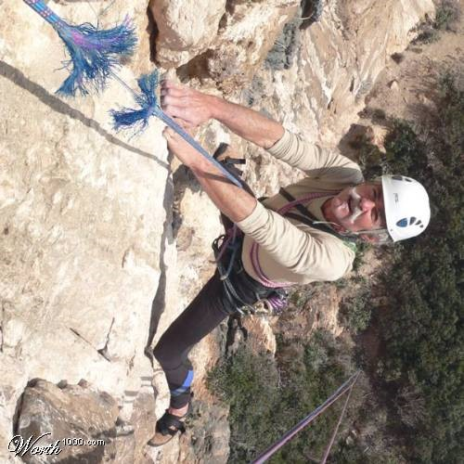
Climb-On Safely
Climbing evolution
Notes:
Jim M.:
And, now for another safety moment
What is the next step this man should consider?
Send his beloved ones the name of the town undertaker.

Slide 42
Study Scenarios
The camp you are assessing runs a very popular provisional winter camp.
Does the camp staff have any additional duties they must perform?
What basis do you have for certifying this camp?
Notes:
Bob:
Work through the exercise
Next Slide

Slide 43
Study Scenarios
If the camp is provisional, the leaders of the unit the youth belong to do not attend. That means the staff must ensure the Youth protection policies are upheld. The council was required to develop a written plan on how they were enforcing YP and have it approved. Thie was the basis for scoring the youth protection program.
Notes:
Bob:
Work through the exercise
Next Slide

Slide 44
Study Scenarios
Camp Nowhere received a donation of several welding machines right before summer camp, They constructed welding booths by draping heavy fire-retardant tarps completely around the machines including a space for the welder to stand. The youth can now earn the welding MB.
Have they done the right thing?
Did they violate any policies?
Notes:
Bob:
Work though the exercise

Slide 45
Study Scenarios
The fire-retardant tarps solved the potential problem of starting fires, but there was no way to watch the youth using the machine, creating a safety violation.
Notes:
Bob:
Work though the exercise

Slide 46
Group Discussion
The night before the assessment the storage building at the waterfront catches fire and they do not have the needed lifejackets – what can they do?
What do you do?
Notes:
:
Note to Presenter: Send them to chat rooms for a brief discussion of the question. Upon returning, discuss the answers of each group. The answer should include:
The applicable standard is PS-201 Aquatics : General. The specific Requirements of the Standard, point B states “Life jackets, paddles, and other equipment are properly sized for all participants.”
Program cannot occur without proper safety equipment. If there were any lifejackets undamaged in the fire, those are usable. This might require a modification in Aquatics procedure to limit participant usage to the number of lifejackets available. This might also require sharing lifejackets (a disinfecting nightmare in the current Wuhan Virus situation). Longer term, the camp needs to procure lifejackets somewhere, somehow if they desire to return to the pre-fire capacity. Borrowing from another camp? Purchasing? Investigate all options.

Slide 47
Study Scenarios
You are given the Food Service facilities to assess. Standard FS-602 states “the camp meets all applicable federal, state and local food storage, handling, preparation, service and facility standards and must have any required licenses.”
What must you do to assess the facility?
Notes:
Bob:
Work though the exercise. Then, refer to and read the verification portion of FS-602.
Review of current local approval of food service operations. If no current
local approval is possible, review of appropriate locally-certified or ServSafe
Manager approval completed shortly prior to or within first week of camp.
Review of cleanliness and sanitary appearance of facilities.

Slide 48
Study Scenarios
You are checking the staff cabins. The first cabin you assess does not have a working smoke detector.
What actions do you take?
How do you score FA- 703?
Notes:
Bob:
Check more cabins to make sure other smoke detectors are working and it is not a systemic problem. TL scores it as Non-compliant.
If the smoke detector (just 1) can be corrected before you leave, score a deviation.
If more smoke detectors are not working, TL contacts area Zone 15 Lead Coordinator and discusses the scoring of a non-compliant. If Zone coordinator agrees, proceed with a corrective action plan.

Slide 49
Study Scenarios
When you begin to assess the camps climbing tower, you observe a youth who has just started his decent from
30 ft above the ground. You can see
he is not properly belayed.
What do you do?
Notes:
Bob: can call on Bill if need be.

Slide 50
Study Scenarios
You notice that the kitchen does not have a fire extinguisher mounted on the wall. The team Leader saw several extra fire extinguishers in the warehouse.
What action should be taken?
Notes:
Bob:
Work through exercise.
Before any fire extinguisher is placed in the kitchen form the extras in the warehouse, it must be determined if it is the appropriate thype of fire extinguisher for the kitchen.

Slide 51
Study Scenarios
What do you do when you observe
several scouts without a buddy?
Notes:
Bob:
Work through the exercise

Slide 52
Questions & Answers
Any Question from Today’s presentation
Ask your Zone Assessment Coordinators
Notes:
Jeff:
Any Questions, use raise your hand function

Slide 53
Zone 15 Contacts:
Z15 Lead Assessment Coord: Jeffrey Irving
jeffreyirving@cox.net 757-646-5218
Z15 Assessment Coord. Jim Miles
jim9miles@aol.com 704-661-0600
Z15 Ass’t Zone Coordinator Paul Corcoran
paulcorcoran187@yahoo.com 336-287-2180
Z15 Ass’t Zone Coordinator Tim Harper
timharper1056@gmail.com 919-988-0470
Z15 Ass’t Zone Coordinator Bob Ormseth
ormseth@comporium.net 803-548-1492
Z15 COPE/Climbing Mentor: Bill Spence
spencewt@aol.com 757-255-0846
Z15 COPE/Climbing Mentor: Sasha Timkovich
timkovich@gmail.com 704-340-0970
Notes:
Jeff:
Here is the contact information for Zone 15

Slide 54
NCAP Resources
For the latest information
Go to:
National
www.scouting.org/ncap
Zone
www.ncapzone15.org
Notes:
Jeff:

Slide 55
Training Certification is good for 1 year CS96 online training code for National NCAP Training CS53 training code for Zone Seminars Be sure your record is updated on My.Scouting.org Thanks for Attending
Notes:
Jeff:
Thanks for coming today: I hope each of you got what you were coming for. If not, feel free to ask any one of the team questions.
End Slide Show

Slide 56
Study Scenarios
Actual situations that have occurred during an assessment
Use the Chat function to provide your answer
Scenarios can have more than one answer
Notes:
We are going to use the Chat function a lot today. First, at anytime you can pose a question to us. Blank will be monitoring the chat input. He will ensure all questions get answered. The answer could come from our presentation today. If so, you will see the rely “answered in presentation” If it is not answered in the presentation, Periodically, the presenter will request if there are questions needing answers, The person monitoring will pose the question to the presenter for an answer,

